Slide 1
Dividing a fraction by a fraction
Arithmetic procedures with fractions

Slide 2
how to use Oak lessons

Slide 3
I can use the mathematical structures that underpin the division of fractions to divide a fraction by a fraction

Slide 4
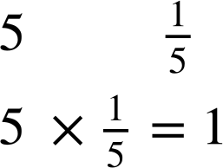
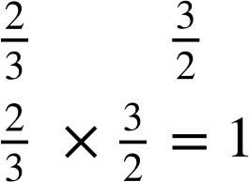
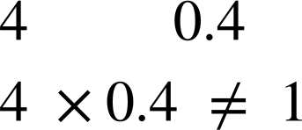
A reciprocal is the multiplicative inverse of any non-zero number. Any non-zero number multiplied by its reciprocal is equal to 1.
Example
Example
Non example
and
and
and

Slide 5

Dividing a fraction by a fraction
Dividing two fractions
Reciprocals
Division by multiplying by the reciprocal

Slide 6

Dividing two fractions
There are a few ways to think about division.
For example,
8 shared by 2
Unitising
8 grouped into 2s
1 | 1 | 1 | 1 | 1 | 1 | 1 | 1
unit
unit
unit
unit
Essentially, we are finding out how many times the divisor fits into the dividend. We can show division of fractions using this simple concept.

Slide 7
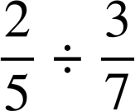
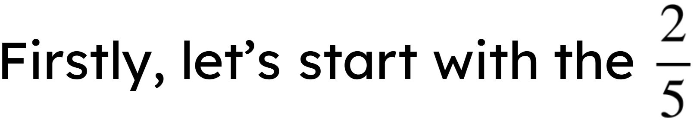
Dividing two fractions
Let’s visualise this question in a bar model

Slide 8
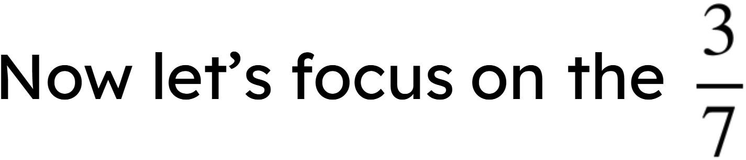
Dividing two fractions
Let’s visualise this question in a bar model

Slide 9
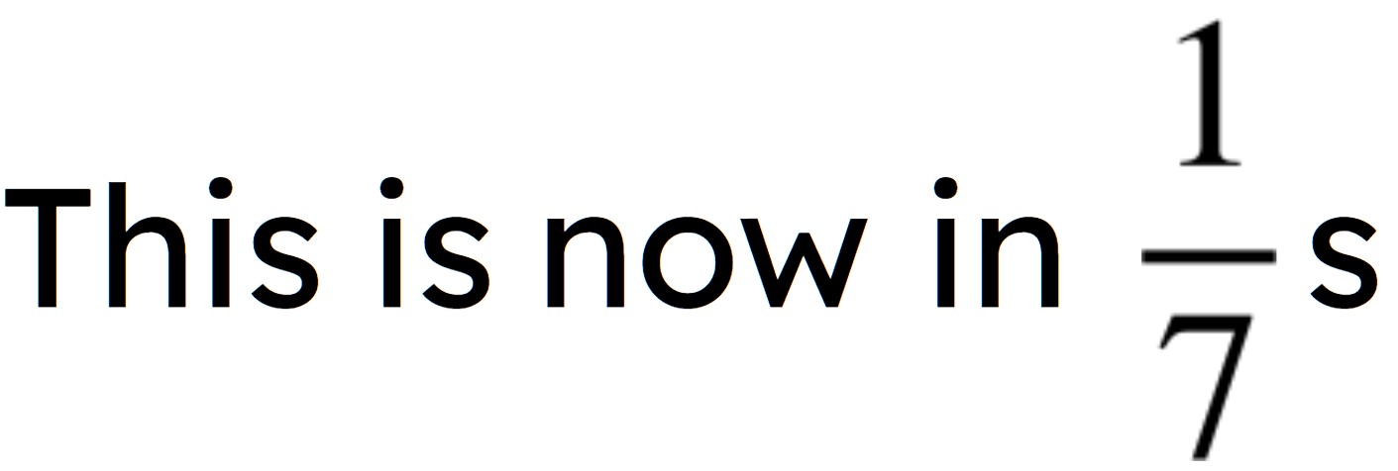
Dividing two fractions
Let’s visualise this question in a bar model

Slide 10
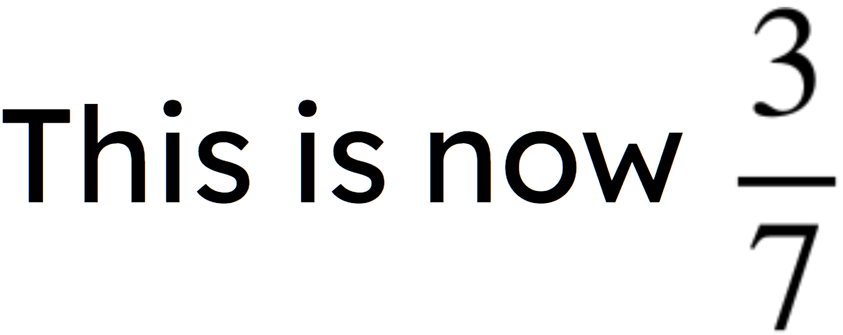
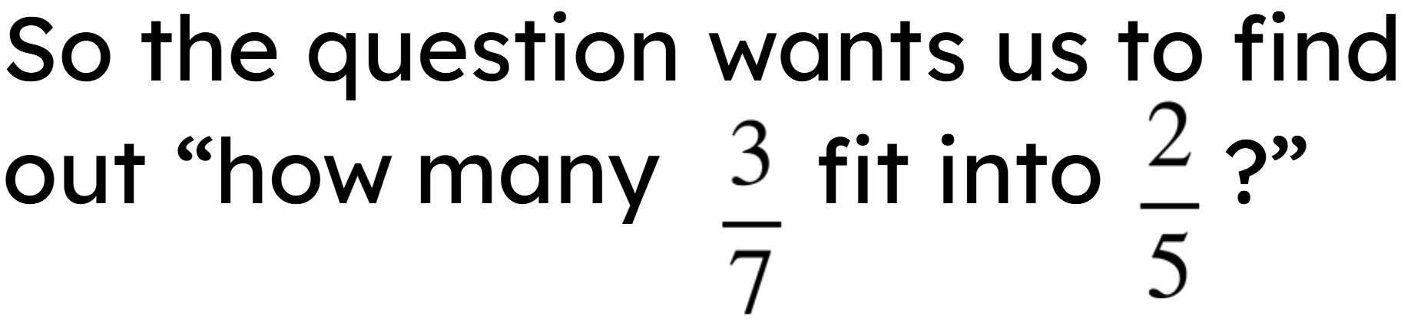
Dividing two fractions
Let’s visualise this question in a bar model

Slide 11
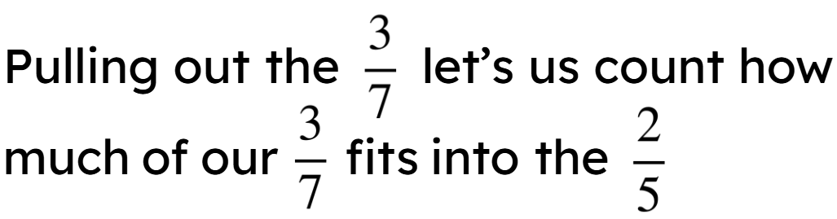
Dividing two fractions
Let’s visualise this question in a bar model

Slide 12
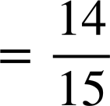
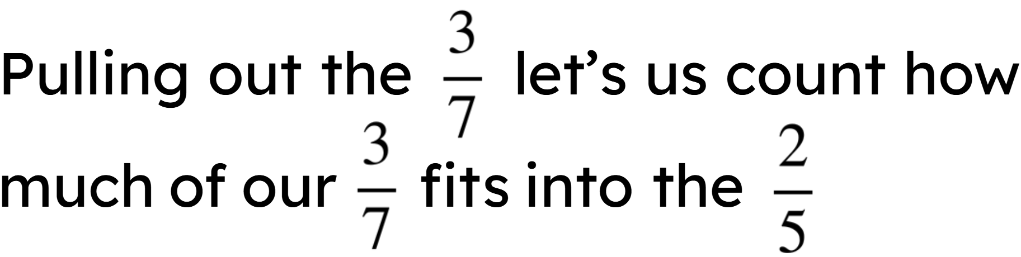
Dividing two fractions
Let’s visualise this question in a bar model

Slide 13
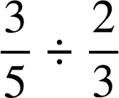
Dividing two fractions
Work out the answer to the following. You can use these templates for the area model if it helps.

Slide 14
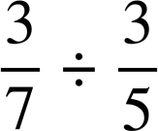
Dividing two fractions
2) Work out the answer to the following. You can use these templates for the area model if it helps.

Slide 15
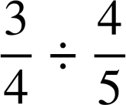
Dividing two fractions
3) Work out the answer to the following by drawing area models. Use squared paper if it helps.

Slide 16
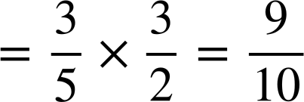

Dividing two fractions
Work out the answer to the following. You can use these templates for the area model if it helps.

Slide 17
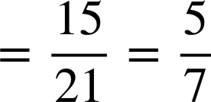
Dividing two fractions
2) Work out the answer to the following. You can use these templates for the area model if it helps.

Slide 18
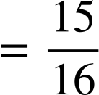
Dividing two fractions
3) Work out the answer to the following by drawing area models. Use squared paper if it helps.

Slide 19
Dividing a fraction by a fraction
Dividing two fractions
Reciprocals
Division by multiplying by the reciprocal

Slide 20
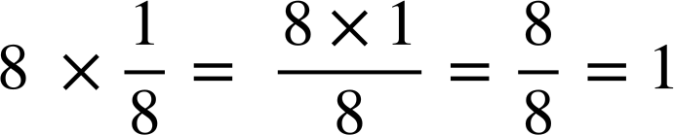
Reciprocals
A reciprocal is the multiplicative inverse of any non-zero number. Any non-zero number multiplied by its reciprocal is equal to 1.
For example, what is the reciprocal of 8?

Slide 21
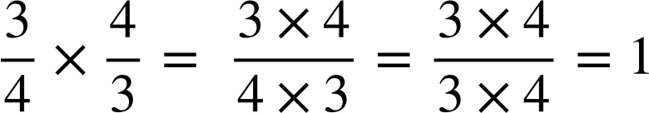
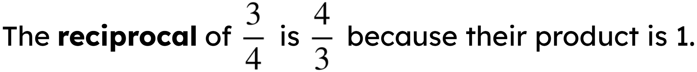
Reciprocals
What do you think we multiply by to make the product of 1?

Slide 22

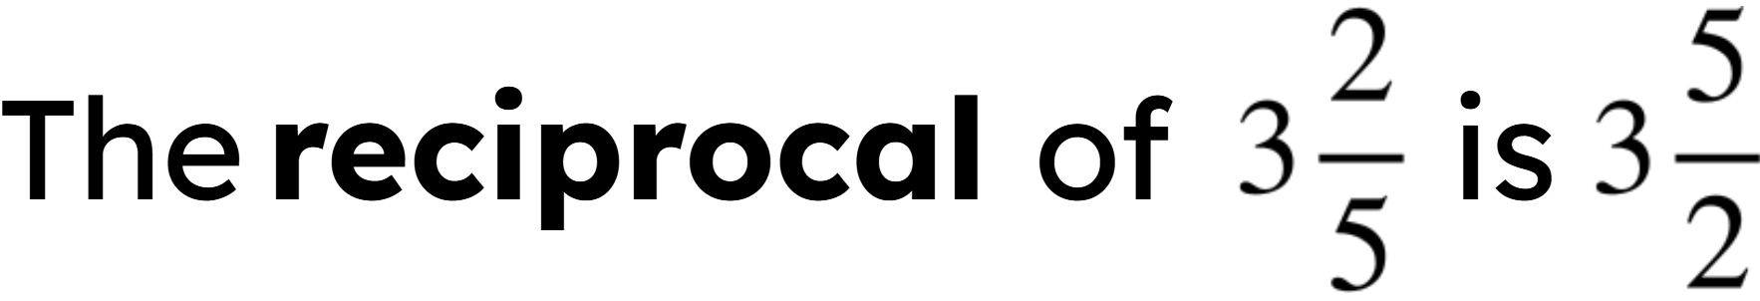


Reciprocals
Sam says:
Is Sam correct? Explain.
Sam is incorrect. Sam could convert the mixed number
into an improper fraction, , and then find the reciprocal

Slide 23
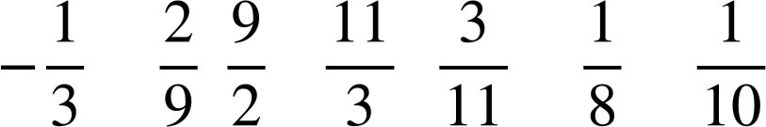
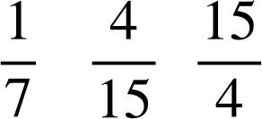
Reciprocals
Work out the reciprocals of the following.
8
10
7
-3
e)
f)
g)
h) 1

Slide 24
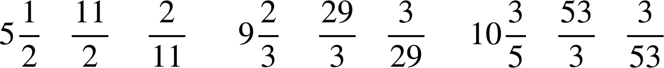
Reciprocals
2) Work out the reciprocals of the following.
a)
b)
c)

Slide 25
Reciprocals
3) Using the cards only once, make the following statements true.
1
2
2
4
5
8
10
The
reciprocal
of
is
The
reciprocal
of
is

Slide 26
Reciprocals
Work out the reciprocals of the following.
8
10
7
-3
e)
f)
g)
h) 1
reciprocal is
reciprocal is
reciprocal is
reciprocal is
reciprocal is
reciprocal is
reciprocal is
reciprocal is 1

Slide 27

Reciprocals
2) Work out the reciprocals of the following.
a)
b)
c)
reciprocal is
reciprocal is
reciprocal is

Slide 28
Reciprocals
3) Using the cards only once, make the following statements true.
1
2
2
4
5
8
10
E.g.
1
4
10
2
The
reciprocal
of
is
The
reciprocal
of
is
2
5
8
This is an equivalent fraction to the reciprocal

Slide 29
Dividing a fraction by a fraction
Dividing two fractions
Reciprocals
Division by multiplying by the reciprocal

Slide 30
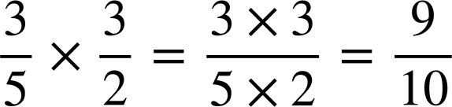
Division by multiplying by the reciprocal
Work out these two calculations.

Slide 31
Division by multiplying by the reciprocal
Work out these two calculations.

Slide 32
Division by multiplying by the reciprocal
Work out these two calculations.
What do you notice?
Dividing by a number and multiplying by the reciprocal of that number give the same result.
Do you think this will always work?

Slide 33


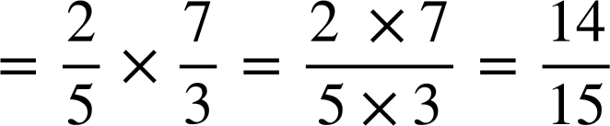
Division by multiplying by the reciprocal
So let’s look at the understanding of why it works.
For example, before we looked at this calculation:

Slide 34
Division by multiplying by the reciprocal
5
2
3
How much of this rectangle…
5
7
3
…fits into this rectangle?

Slide 35
Division by multiplying by the reciprocal
5
2
3
Multiplying by the reciprocal of the divisor gives us the same answer.
7

Slide 36
Division by multiplying by the reciprocal
Division can be re-written as multiplying by the reciprocal.
This works all of the time, but can make calculations, particularly those involving fractions, more efficient.

Slide 37
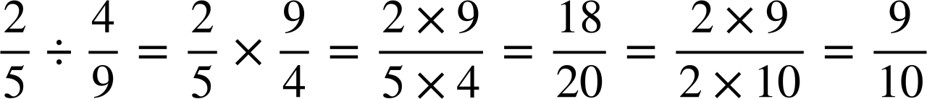
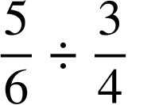
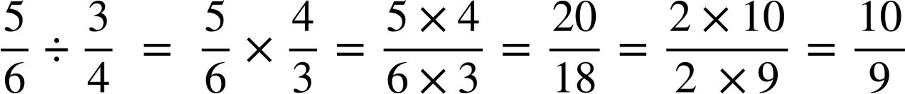
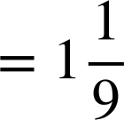
Division by multiplying by the reciprocal
Work out the answer to
Show all your working out and simplify where possible.
Work out the answer to
Show all your working out and simplify where possible.

Slide 38
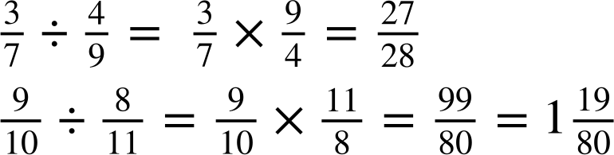
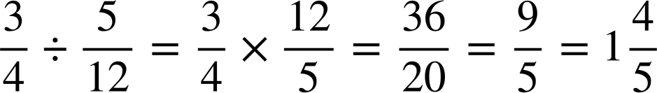
Division by multiplying by the reciprocal
1) Work out the answers to the following, simplifying your answer where necessary.
a)
b)
c)

Slide 39
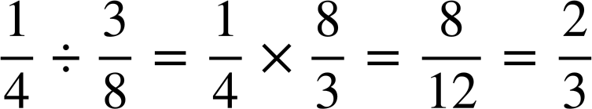

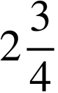
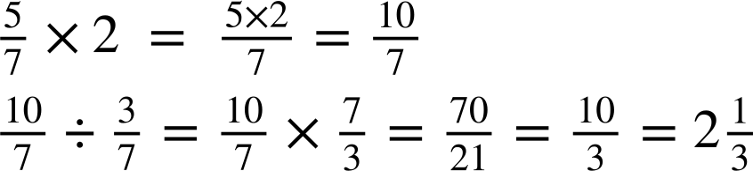
Division by multiplying by the reciprocal
2) Here are some areas of some shapes. Work out the missing lengths.
a)
b)
m
?
cm
?
m
Area
=
m²
cm
Area
=
cm²
c)
m
Area
=
m²
?
m

Slide 40
Division by multiplying by the reciprocal
1) Work out the answers to the following, simplifying your answer where necessary.
a)
b)
c)

Slide 41
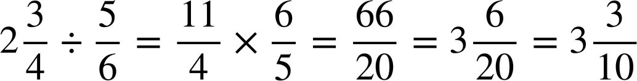
Division by multiplying by the reciprocal
2) Here are some areas of some shapes. Work out the missing lengths.
a)
m
b)
cm
?
?
m
Area
=
m²
cm
Area
=
cm²

Slide 42
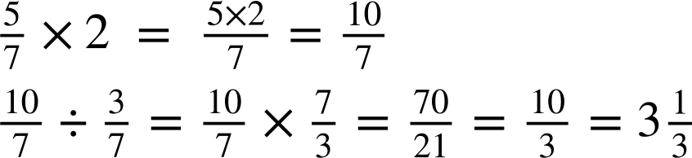
Division by multiplying by the reciprocal
2) Here are some areas of some shapes. Work out the missing lengths
c)
m
Area
=
m²
?
m

Slide 43
Dividing a fraction by a fraction
The division of a fraction by a fraction can be seen using an area model.
A reciprocal is the multiplicative inverse of any non-zero number. Any non-zero number multiplied by its reciprocal is equal to 1.
However, it is easier to calculate the division of a fraction by a fraction, by multiplying the dividend by the reciprocal of the divisor.

Slide 44

© Oak National Academy 2023.
Produced in partnership with Mathematics in Education and Industry.
Licensed on the Open Government Licence v3.0, except where otherwise stated. See Oak terms and conditions.

